Slide 1


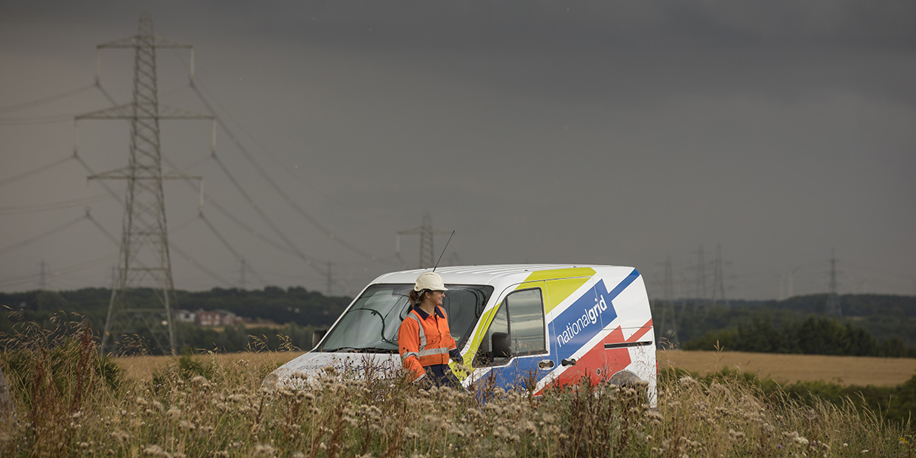
Global Data OKR’s
February 2022

Slide 2
Data OKR’s – Objective Hierarchy
There is a common approach to conducting data activities
Data is managed as an Asset
Data initiatives lead with Value and Outcomes
Team Principles
Individual Objectives
Consistency of approach and time saved delivered by business units using standardised DG artifacts (Ken)
Common modelling patterns are used across the Enterprise
Data decisions are made in a collaborative manner
(All)
The level of organisational data risk is understood and managed (Ken)
There is a strategy in place based on business outcomes (Andrew)
Deviations from reference architecture are managed
(Krishna)
Insight is driven by the Advanced Analytics lab
(Krishna)
All data initiatives are linked back to business outcomes
(All)
X% of business units are capturing data definitions using standard methods (Ken)
Z% of business units have adopted the DM BMS (Ken)
Y% of business units have logical data models in place (Krishna)
X% Business units signoff the data models and own changes to models ( Krishna)
Y% of engagement at EADSC (Ken)
X% of engagement at architecture review board (Krishna)
Z% of the projects aligning with strategic decisions within NG ( Krishna)
X number of critical Business units working in collaboration to develop reference architecture ( Krishna)
Y% conformance to reference architecture and identifying the changes/ deviations needed and managing via guard rails ( Krishna )
X% consolidation of reporting and analytical tools saving cost and duplication ( Krishna )
Identify X number of opportunities that leads towards advancement in analytics ( AI / ML ) ( Krishna)
X% cost savings in consolidation of capabilities and removal of duplication of risk ( All )
Key Results

Slide 3
Data OKR’s – Objective Hierarchy
Comply and cotinuously improve ways of working
Better ways to deliver organization capabilities
Team Principles
Individual Objectives
Trainings and PDP’s (All)
Improve visibility of work done - Internal / external (All)
Improve Internal capabilities
Grow NG capabilities
Industry thought leadership
Ensure team members complete x% of trainings and develop < n > number of new skills and apply them ( all )
Ensure all team members have a well defined PDP and growth path ( All)
Complaints to timesheets and training needs
Ensure that good work done by team if visible with <n> number of internal references ( All)
Participate in <n> number of external events promoting digital maturity of NG and ensure we attract best talent (All)
Participate in <x> number of cadence calls in architecture forums across NG ( All)
Improve internal capabilities within organization by reducing dependency on expensive consultants and service integrators by < X %> ( All)
Promote diversity within the team and improve by <x%> ( All)
Look out for NEAR SHORING / OFF SHORING the capabilities within NG. Create <n> proposals for Off shoring or BOT models saving <X Million USD> for national Grid ( Krishna)
Craft white papers / Industry views on technology advancements and publish in Internal / external sites < n > Number ( Krishna )
Key Results

Slide 4
OKR​ | Grading​ | Status​
Principle - There is a common approach to conducting data activities Objective 1: Common reusable Data patterns across the Enterprise Establish Common MDM Data patterns using JSON and REST API for various business unit use Establish Common Batch data patterns using data files for various business unit use Establish Common pattern to sync curated Reltio master data into Snowflake for the various business use Establish Various integration patterns to be leverage by | ​
0.0​ | 0.1​ | 0.2​ | 0.3​ | 0.4​ | 0.5​ | 0.6​ | 0.7​ | 0.8​ | 0.9​ | 1.0​
We failed to make real progress – what were the main blockers?​ |  |  |  | We made progress – how can we improve next time?​ |  |  | We delivered – were the objectives ambitious enough?​

Slide 5
OKR​ | Grading​ | Status​
Principle – Data is managed as an Asset Objective 2: Build or help build Grid Data Asset of various business units Deliver value by supporting US Customer CDP initiative Deliver value by supporting Global Workforce WDD initiative Support other business units in their key digital initiatives Support various business unit building business case for new GridData Assets | ​
0.0​ | 0.1​ | 0.2​ | 0.3​ | 0.4​ | 0.5​ | 0.6​ | 0.7​ | 0.8​ | 0.9​ | 1.0​
We failed to make real progress – what were the main blockers?​ |  |  |  | We made progress – how can we improve next time?​ |  |  | We delivered – were the objectives ambitious enough?​

Slide 6
OKR​ | Grading​ | Status​
Principle – Comply with ways of working Objective 5: Trainings, PDP’s, promoting NG visibility 1.0: 100% compliance in filling timesheets 100% adherence to organization trainings Identify 2 skills gaps and develop PDP’s to address the gaps 2 External trainings a Year – aligned with skill gaps 3 White papers / Year on data concepts – Published in group site Nominated as a speaker 2 times in industry conferences Promote 30% diversity in the teams 30% cost savings in owning the in-sourcing tasks reducing reliance on external vendors 0.7:​ 100% compliance in filling timesheets 100% adherence to organization trainings Identify 2 skills gaps and develop PDP’s to address the gaps 2 External training a Year – aligned with skill gaps 2 White papers / Year on data concepts – Published in group site Promote 30% diversity in the teams 0.3: Not meeting all of above | ​
0.0​ | 0.1​ | 0.2​ | 0.3​ | 0.4​ | 0.5​ | 0.6​ | 0.7​ | 0.8​ | 0.9​ | 1.0​
We failed to make real progress – what were the main blockers?​ |  |  |  | We made progress – how can we improve next time?​ |  |  | We delivered – were the objectives ambitious enough?​

Slide 7
OKR​ | Grading​ | Status​
Principle – Comply with ways of working Objective 5: Trainings, PDP’s, promoting NG visibility 1.0: 100% compliance in filling timesheets 100% adherence to organization trainings Identify 2 skills gaps and develop PDP’s to address the gaps 2 External trainings a Year – aligned with skill gaps 3 White papers / Year on data concepts – Published in group site Nominated as a speaker 2 times in industry conferences Promote 30% diversity in the teams 30% cost savings in owning the in-sourcing tasks reducing reliance on external vendors 0.7:​ 100% compliance in filling timesheets 100% adherence to organization trainings Identify 2 skills gaps and develop PDP’s to address the gaps 2 External training a Year – aligned with skill gaps 2 White papers / Year on data concepts – Published in group site Promote 30% diversity in the teams 0.3: Not meeting all of above | ​
0.0​ | 0.1​ | 0.2​ | 0.3​ | 0.4​ | 0.5​ | 0.6​ | 0.7​ | 0.8​ | 0.9​ | 1.0​
We failed to make real progress – what were the main blockers?​ |  |  |  | We made progress – how can we improve next time?​ |  |  | We delivered – were the objectives ambitious enough?​

Slide 8
Enable the energy transition for all
Deliver for our customers efficiently
Grow our organizational capability
Empower our people for great performance

Slide 9
OKR​ | Grading​ | Status​
Principle - Data initiatives lead with Value and Outcomes Objective 2: Data decisions are made in a collaborative manner 1.0: Critical Business units ( 6/8 across NG) have visibility of strategic tools used within Enterprise Gaps in new Business capabilities are identified and promptly addresses with respect to options analysis and recommendation are made ( within 3 months) When Business units do not conform to Strategic stack of tools, risks are raised and Business owners are persuaded to own the risks and mitigations ( at least 75% of deviations are recorded and managed) Adjustments to strategic stack of tools are identified and new capabilities are cascaded Cost effective measures of implementing new strategic capabilities are identified to demonstrate continuous improvement Convergence on strategic capabilities is demonstrated by Business units ( at least 2 a Year) Framework for Data capabilities consolidation are crafted and implemented ( Minimum savings of 3 Mil+ USD is demonstrated) 0.7:​ Critical Business units ( 6/8 across NG) have visibility of strategic tools used within Enterprise Gaps in new Business capabilities are identified and escalated ( within 3 months) When Business units do not conform to Strategic stack of tools, risks are raised Adjustments to strategic stack of tools are identified and new capabilities are cascaded Convergence on strategic capabilities is demonstrated by Business units ( at least 2 a Year) Framework for Data capabilities consolidation are crafted and implemented ( Minimum of 1 Mil+ USD is demonstrated) 0.3: Not meeting all of above | ​
0.0​ | 0.1​ | 0.2​ | 0.3​ | 0.4​ | 0.5​ | 0.6​ | 0.7​ | 0.8​ | 0.9​ | 1.0​
We failed to make real progress – what were the main blockers?​ |  |  |  | We made progress – how can we improve next time?​ |  |  | We delivered – were the objectives ambitious enough?​

Slide 10
OKR​ | Grading​ | Status​
Principle - There is a common approach to conducting data activities Objective 3: Deviations from reference architecture are managed 1.0: Well defined reference architecture agreed and acknowledged by 6/8 of Business units Reference architecture demonstrating a indicative 3 Year plan aligned with Business aspirations and demonstrating interim stages and covering the Technical reference models Deliver 5 Guardrails data capabilities by end of Year 2022 Develop atleast 3 new data domain standards by end of year 2022 0.7:​ Well defined reference architecture agreed and acknowledged by 4/8 of Business units Deliver 3 Guardrails data capabilities by end of Year 2022 Develop atleast 2 new data domain standards by end of year 2022 0.3: Not meeting all of above | ​
0.0​ | 0.1​ | 0.2​ | 0.3​ | 0.4​ | 0.5​ | 0.6​ | 0.7​ | 0.8​ | 0.9​ | 1.0​
We failed to make real progress – what were the main blockers?​ |  |  |  | We made progress – how can we improve next time?​ |  |  | We delivered – were the objectives ambitious enough?​
Notes:
8

Slide 11
OKR​ | Grading​ | Status​
Principle – Data initiatives lead with Value and Outcomes Objective 4: All data initiatives are linked back to business outcomes via strategy / Digitial product development 1.0: Support 4 Business units in delivering Data architecture, strategy and governance initiatives Data council is established and participated by 5 Business units Stakeholder engagement in 50% of the M&A initiatives with ownership of domain integrations and demonstrating cost savings Support MVP delivery of 6 products a Year Participate in Data maturity assessment and craft plans to improve Data maturity 0.7:​ Support 2 Business units in delivering Data architecture, strategy and governance initiatives Data council is established and participated by 5 Business units Stakeholder engagement in 50% of the M&A initiatives Support MVP delivery of 3 products a Year 0.3: Not meeting all of above | ​
0.0​ | 0.1​ | 0.2​ | 0.3​ | 0.4​ | 0.5​ | 0.6​ | 0.7​ | 0.8​ | 0.9​ | 1.0​
We failed to make real progress – what were the main blockers?​ |  |  |  | We made progress – how can we improve next time?​ |  |  | We delivered – were the objectives ambitious enough?​

Slide 12
OKR​ | Grading​ | Status​
Principle – Comply with ways of working Objective 5: Trainings, PDP’s, promoting NG visibility 1.0: 100% compliance in filling timesheets 100% adherence to organization trainings Identify 2 skills gaps and develop PDP’s to address the gaps 2 External trainings a Year – aligned with skill gaps 3 White papers / Year on data concepts – Published in group site Nominated as a speaker 2 times in industry conferences Promote 30% diversity in the teams 30% cost savings in owning the in-sourcing tasks reducing reliance on external vendors 0.7:​ 100% compliance in filling timesheets 100% adherence to organization trainings Identify 2 skills gaps and develop PDP’s to address the gaps 2 External training a Year – aligned with skill gaps 2 White papers / Year on data concepts – Published in group site Promote 30% diversity in the teams 0.3: Not meeting all of above | ​
0.0​ | 0.1​ | 0.2​ | 0.3​ | 0.4​ | 0.5​ | 0.6​ | 0.7​ | 0.8​ | 0.9​ | 1.0​
We failed to make real progress – what were the main blockers?​ |  |  |  | We made progress – how can we improve next time?​ |  |  | We delivered – were the objectives ambitious enough?​

